Slide 1
JavaScript Avanzado

Slide 2



¡Hola!, soy
Keneth Murillo
AI & Cloud & DevOps Architect
Salesforce Solution Architect
@kenethmurillo
../in/kenethmurillo/
kmurillo@advancecr.com | keneth.murillo@outlook.com

Slide 3
Contenido
Módulo 1: JavaScript para manipular el DOM
Módulo 2: Media Queries
Módulo 3: Uso de variables numéricas, strings, booleanos
Módulo 4: Uso de condiciones, ciclos, arrays
Módulo 5: Uso de funciones, scope, closure
Módulo 6: Manejo de objetos, prototype, classes, tipado de datos
Módulo 7: Manejo de módulos NodeJS y NPM.

Slide 4
Contenido (cot)
Módulo 8: Funciones para manejo de datos en arreglos: Split, includes, filter, map, reduce, etc.
Módulo 9: React: Renderizado de datos, JSX.
Módulo 10: Comunicación con servicios externos.
Módulo 11: Hojas de estilo en React.
Módulo 12: Flujo de datos con Redux.
Módulo 13: Arquitectura de una aplicación con React, componentes, clases, props.
Módulo 14: Estados y el ciclo de vida de la aplicación.
Módulo 15: Seguridad de aplicaciones con Java Script (JWT)

Slide 5
What is ECMAScript?
Language syntax (parsing rules, keywords, control flow, object literal initialization, ...).
Types (boolean, number, string, function, object, ...)
Error handling mechanisms
A prototype-based inheritance mechanism
Built-in objects and functions, including JSON, Math, Array
Basic memory model

Slide 6
What is JavaScript?
Created by Netscape
Originally called LiveWire then LiveScript
A client-side scripting language
Client-side refers to the fact that it is executed in the client (software) that the viewer is using. In the case of JavaScript, the client is the browser.
A server-side language is one that runs on the Web server. Examples: PHP, Python
Interpreted on-the-fly by the client
Each line is processed as it loads in the browser

Slide 7
JavaScript is not Java
Completely different types of languages that just happen to be similarly named
JavaScript - programs are interpreted in the browser
Java - programs are compiled and can be run as stand-alone applications

Slide 8
Why JavaScript?
It’s easier to learn than most programming languages
It allows you to make interactive Web pages
It can be fun!

Slide 9
Including JavaScript in HTML
Two ways to add JavaScript to Web pages
Use the <script>…</script> tag
Include the script in an external file -- more about this later in the semester

Slide 10
Hello, World!
Typically, in any programming language, the first example you learn displays “Hello, World!”
We are going to take a look at a Hello World example and then examine all of its parts.

Slide 11
Hello World in JavaScript
<!DOCTYPE html>
<html>
<head>
<title>Hello World Example</title>
</head>
<body>
<script type="text/javascript">
<!--
document.write("<h1>Hello, world!</h1>");
//-->
</script>
</body>
</html>

Slide 12
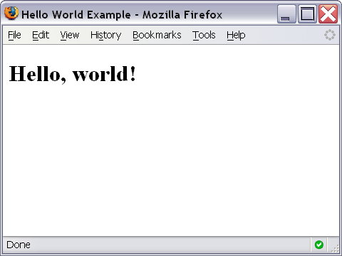
Hello World Screenshot

Slide 13
The <script>…</script> tag
The code for the script is contained in the <script>…</script> tag
<script type="text/javascript">
.
.
.
</script>

Slide 14
Hiding JavaScript from Older Browsers
Some older browsers do not support JavaScript
We need to tell those browsers to ignore what is in the <script> tag
<script type="text/javascript">
<!--
some JavaScript code
//-->
</script>

Slide 15
Displaying text
The document.write() method writes a string of text to the browser
<script type="text/javascript">
<!--
document.write("<h1>Hello, world!</h1>");
//-->
</script>

Slide 16
document.write()
Ends in a semicolon
document.write("<h1>Hello,world!</h1>");
Enclosed in quotes -- denotes a "string"

Slide 17
Comments in JavaScript
Two types of comments
Single line
Uses two forward slashes (i.e. //)
Multiple line
Uses /* and */

Slide 18
Single Line Comment Example
<script type="text/javascript">
<!--
// This is my JavaScript comment
document.write("<h1>Hello!</h1>");
//-->
</script>

Slide 19
Multiple Line Comment Example
<script type="text/javascript">
<!--
/* This is a multiple line comment.
* The star at the beginning of this line is optional.
* So is the star at the beginning of this line.
*/
document.write("<h1>Hello!</h1>");
//-->
</script>

Slide 20
Find the Bug!
<script type="text/javascript">
<!--
/* This is my JavaScript comment
* that spans more than 1 line.
*
document.write("<h1>Hello!</h1>");
//-->
</script>

